Slide 1
Shakespeare Whispers Into Your Ear Folio Technique with Kevin Long

Slide 3
A Hyde Park, London orator in the early 1900’s
The present government here—the most degraded, the most cowardly, the most debased, the most blood thirsty set of sneaking ruffians that ever disgraced the title of so called humanity.

Slide 4
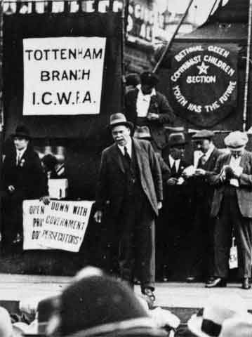
This is how it was printed:
The present Government Har. The most Abandoned. The most Degraded! The most Cowardly! The most Debased! The most Ber-lud-thirsty! Set. Of Sneakin’ Ruffians. That hever disgraced the Title. Of so-called Yumanity.
Buckley, Kate. "First Folio Technique Guidelines for Actors." 1997.

Slide 5
The Lord Chamberlain’s Men
In a 189 day period
150 performances
30 different plays
58 performances
14 new plays that season
1594-1597
Leading actor = 71 roles
53 of which were new roles within this 3 year period
Buckley, Kate. "First Folio Technique Guidelines for Actors." 1997

Slide 6
“…every one according to his cue.”

Slide 7
Macbeth II.2.40-45
Macbeth
Still it cry’d, Sleepe no more to all the House:
Glamis hath murther’d Sleepe, and therefore Cawdor
Shall sleepe no more: Macbeth shall sleepe no more.
Lady
Who was it, that thus cry’d? why worthy Thane,
You doe unbend your Noble strength, to thinke
So braine-sickly of things: Goe get some Water,
And wash this filthie Witnesse from your Hand.

Slide 8
Macbeth II.2.40-45
Macbeth
Still it cry’d, Sleepe no more to all the House:
Glamis hath murther’d Sleepe, and therefore Cawdor
Shall sleepe no more: Macbeth shall sleepe no more.
Lady
Who was it, that thus cry’d? why worthy Thane,
You doe unbend your Noble strength, to thinke
So braine-sickly of things: Goe get some Water,
And wash this filthie Witnesse from your Hand.

Slide 9
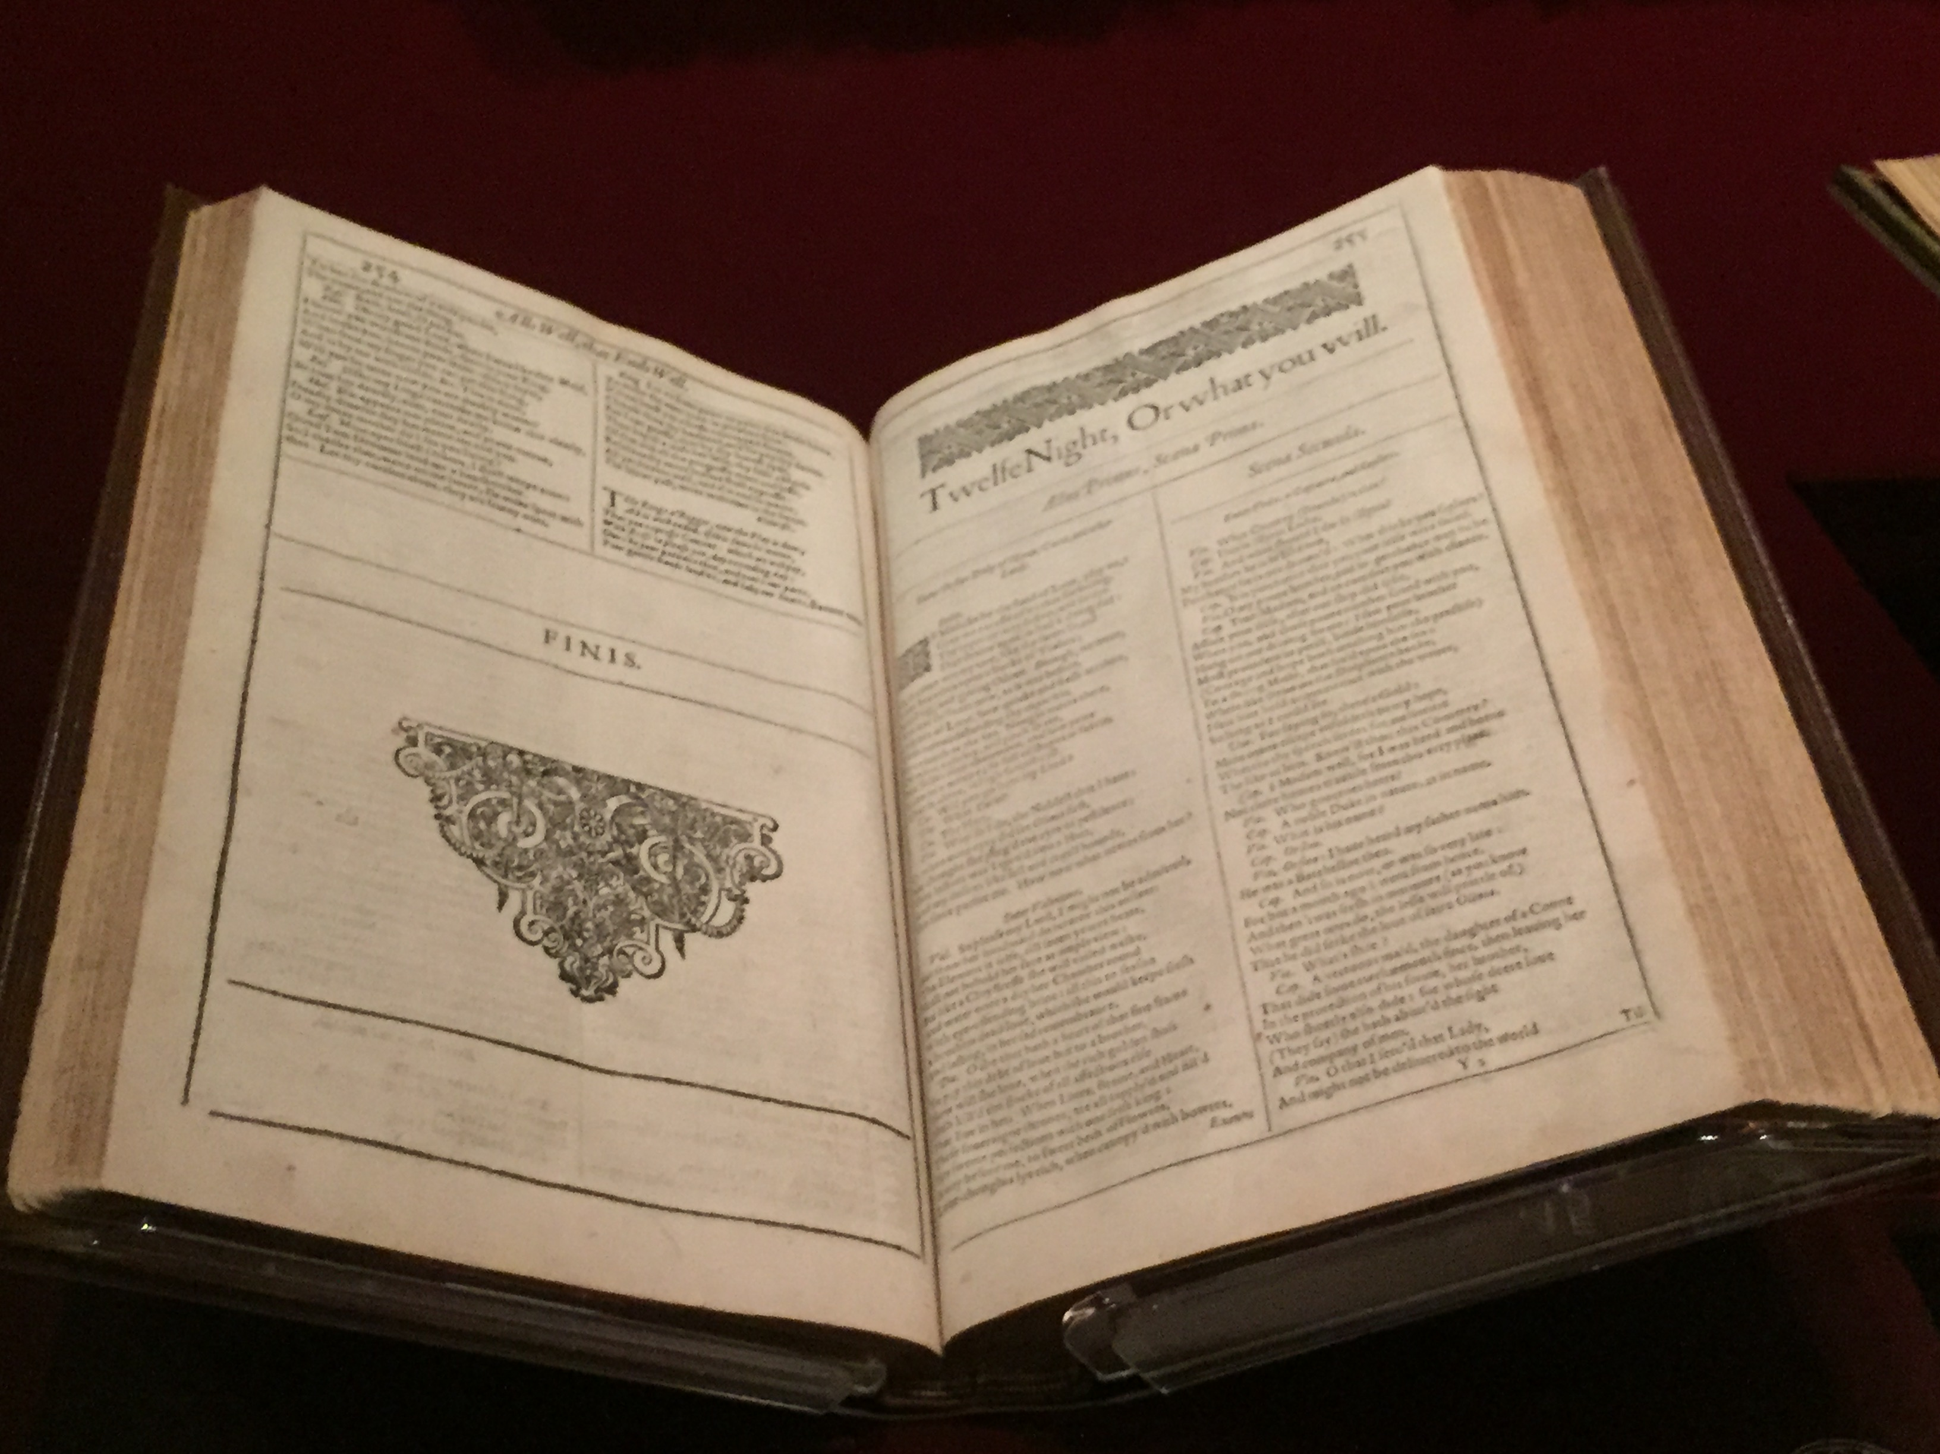
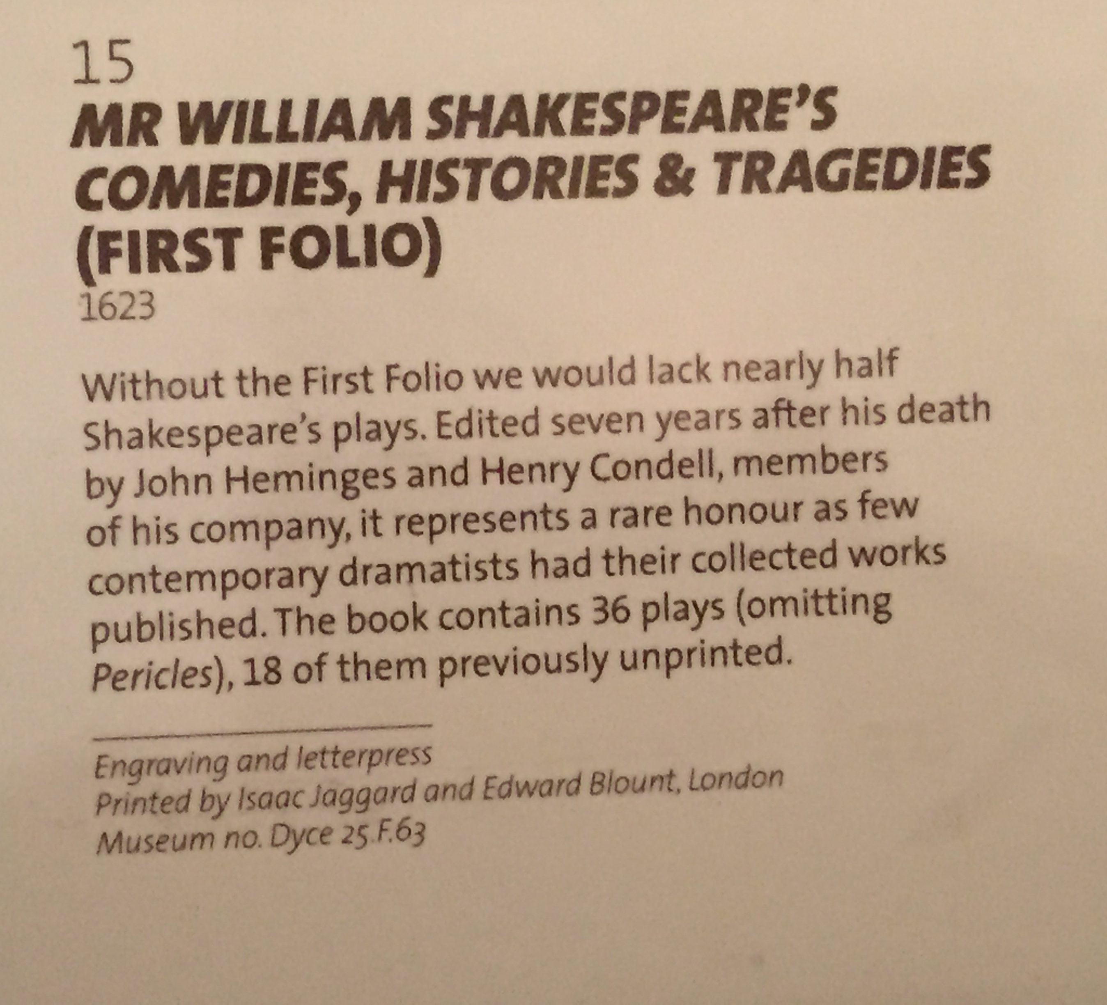
John Heminges & Henry Condell

Slide 10
Why must I use these words NOW?

Slide 11
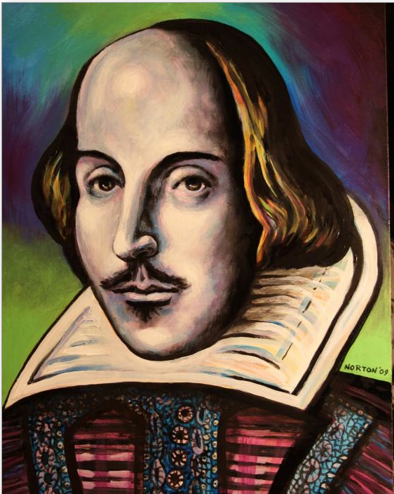
THANK YOU BILL!

Slide 12
Better Alive than Perfect

Slide 13
The Index Card Trick

Slide 14
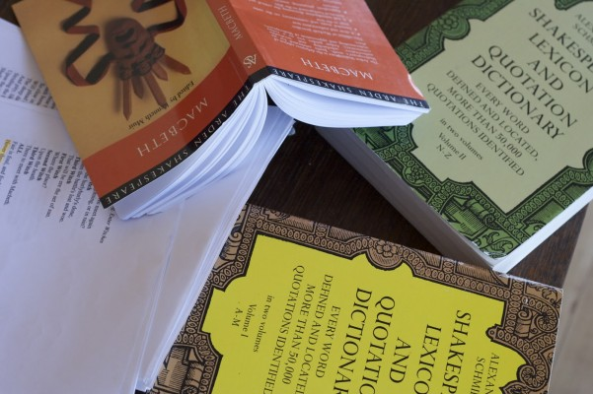
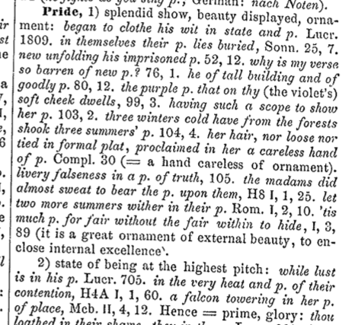
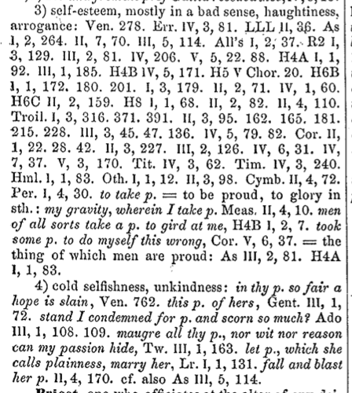
DEFINITIONS
Know exactly what you are saying at ALL times.
As You Like It
Phoebe: But sure he's proud, and yet his pride becomes him.

Slide 15
DEFINITIONS
As You Like It
Phoebe: But sure he's proud, and yet his pride becomes him.

Slide 16
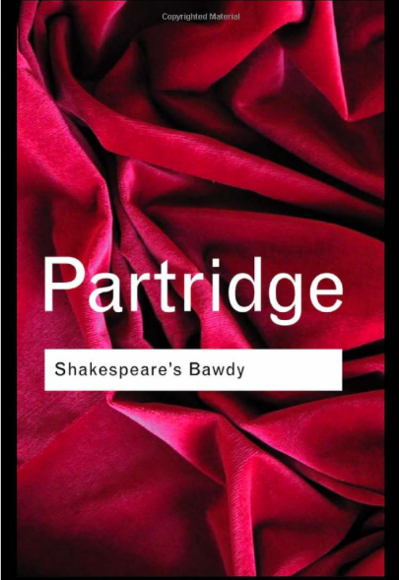
DEFINITIONS
As You Like It
Phoebe: But sure he's proud, and yet his pride becomes him.

Slide 17
Shakespeare Pro By PlayShakespeare.com
Shakespeare Pro® includes complete works of Shakespeare (41 plays, 154 sonnets and 6 poems, including doubtful works), integrated glossary from Shakespeare’s Words and search the concordance to find the exact word or phrase you’re looking for (with “relaxed” searching to find words close to your search term).

Slide 18
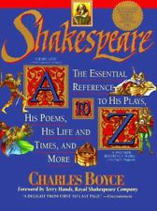
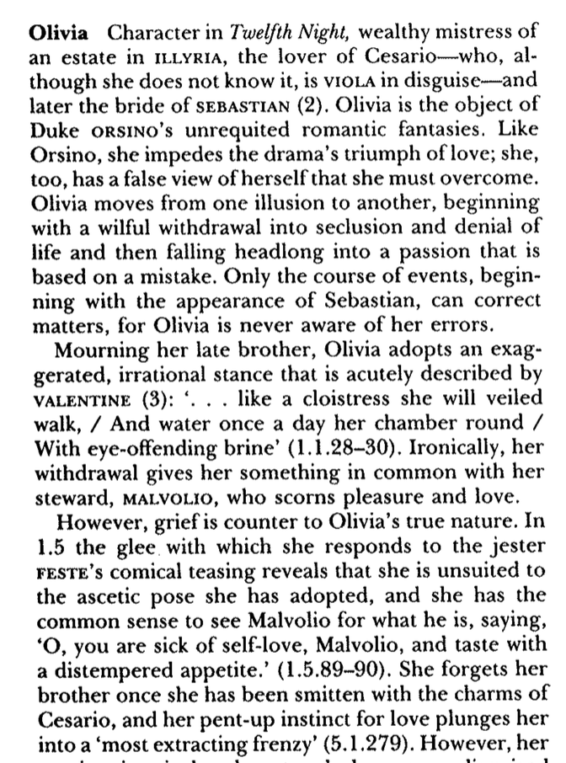
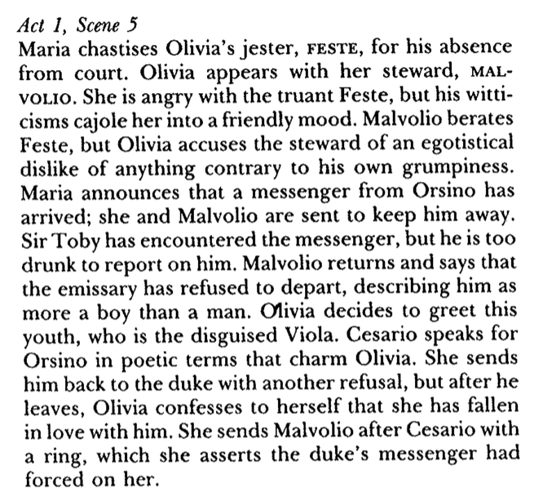
DEFINITIONS

Slide 19
Twelfth Night I.5.244-254
Olivia: What is your Parentage?
Aboue my fortunes, yet my state is well;
I am a Gentleman. Ile be sworne thou art,
Thy tongue, thy face, thy limbes, actions, and spirit,
Do giue thee fiue-fold blazon: not too fast: soft, soft. 5
Vnlesse the Master were the man. How now?
Euen so quickly may one catch the plague?
Me thinkes I feele this youths perfections
With an inuisible, and subtle stealth
To creepe in at mine eyes. Well, let it be. 10

Slide 20
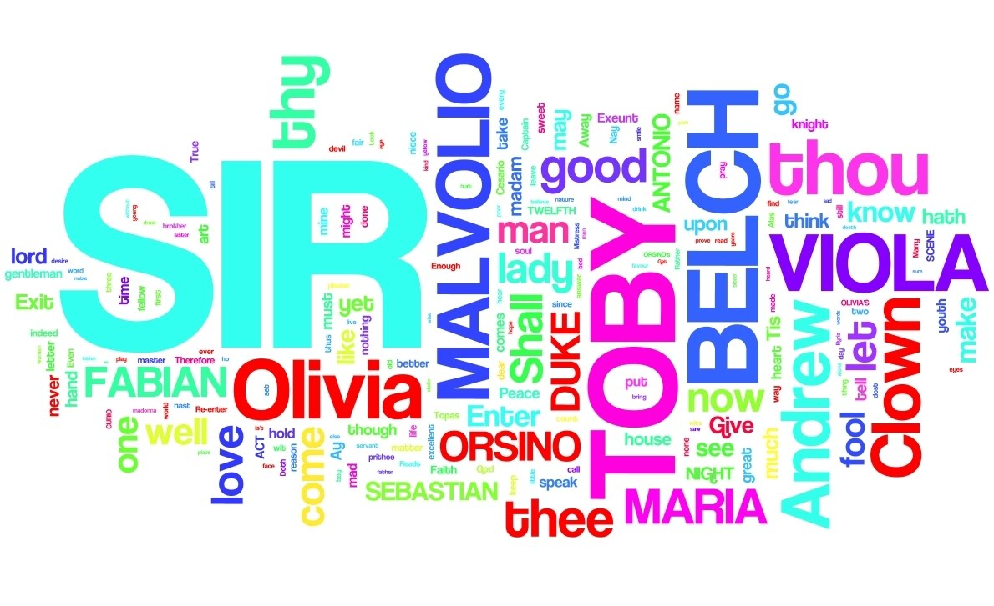
EXERCISE: Language Exploration

Slide 21
SPELLING
The Tempest
Gonz: Mercy on vs.
We fplit, we fplit, Farewell my wife and child
Farewell brother: we fplit, we fplit, we fplit.
Do we pronounce the extra syllable or not?
Unvoiced syllable – ’d and ’st banish’d / know’st / thron’d / see’st
Voiced syllable – ed and est banished / knowest / throned / seest
Juliet: …Faine would I dwell on forme, faine, faine, denie
What I have spoke, but farewell Complement,
Doest thou Love?

Slide 22
ECPHONESIS O
Orsino: O when mine eyes did see Olivia first,
Methought she purged the air of pestilence;
Juliet: O God, she comes! O honey Nurse, what news?
Nurse: My back a’ t’other side: O my back, my back!

Slide 23
Full Thought
. PERIOD ! EXCLAMATION POINT ? QUESTION MARK

Slide 24
Twelfth Night I.5.244-254
Olivia: What is your Parentage?
Aboue my fortunes, yet my state is well;
I am a Gentleman. Ile be sworne thou art,
Thy tongue, thy face, thy limbes, actions, and spirit,
Do giue thee fiue-fold blazon: not too fast: soft, soft. 5
Vnlesse the Master were the man. How now?
Euen so quickly may one catch the plague?
Me thinkes I feele this youths perfections
With an inuisible, and subtle stealth
To creepe in at mine eyes. Well, let it be. 10

Slide 25
Exercise: Full Thought Musical Chairs
. PERIOD ! EXCLAMATION POINT ? QUESTION MARK

Slide 26
Twelfth Night I.5.244-254
Olivia: What is your Parentage?
Aboue my fortunes, yet my state is well;
I am a Gentleman. Ile be sworne thou art,
Thy tongue, thy face, thy limbes, actions, and spirit,
Do giue thee fiue-fold blazon: not too fast: soft, soft. 5
Vnlesse the Master were the man. How now?
Euen so quickly may one catch the plague?
Me thinkes I feele this youths perfections
With an inuisible, and subtle stealth
To creepe in at mine eyes. Well, let it be. 10

Slide 27
Full Stops
. PERIOD ! EXCLAMATION POINT ? QUESTION MARK

Slide 28
Twelfth Night I.5.244-254
Olivia: What is your Parentage?
Aboue my fortunes, yet my state is well;
I am a Gentleman. Ile be sworne thou art,
Thy tongue, thy face, thy limbes, actions, and spirit,
Do giue thee fiue-fold blazon: not too fast: soft, soft. 5
Vnlesse the Master were the man. How now?
Euen so quickly may one catch the plague?
Me thinkes I feele this youths perfections
With an inuisible, and subtle stealth
To creepe in at mine eyes. Well, let it be. 10
B
THANK
YOU BILL!
B
B
B
B

Slide 29
MID STOPS
. PERIOD ! EXCLAMATION POINT ? QUESTION MARK

Slide 30
Twelfth Night I.5.244-254
Olivia: What is your Parentage?
Aboue my fortunes, yet my state is well;
I am a Gentleman. Ile be sworne thou art,
Thy tongue, thy face, thy limbes, actions, and spirit,
Do giue thee fiue-fold blazon: not too fast: soft, soft. 5
Vnlesse the Master were the man. How now?
Euen so quickly may one catch the plague?
Me thinkes I feele this youths perfections
With an inuisible, and subtle stealth
To creepe in at mine eyes. Well, let it be. 10
B
THANK
YOU BILL!
B
B
B
B

Slide 31
COLONS & SEMI-COLONS

Slide 32
Twelfth Night I.5.244-254
Olivia: What is your Parentage?
Aboue my fortunes, yet my state is well;
I am a Gentleman. Ile be sworne thou art,
Thy tongue, thy face, thy limbes, actions, and spirit,
Do giue thee fiue-fold blazon: not too fast: soft, soft. 5
Vnlesse the Master were the man. How now?
Euen so quickly may one catch the plague?
Me thinkes I feele this youths perfections
With an inuisible, and subtle stealth
To creepe in at mine eyes. Well, let it be. 10
B
T
THANK
YOU BILL!
T
T
B
B
B
B

Slide 33
COMMAS

Slide 34
Twelfth Night I.5.244-254
Olivia: What is your Parentage?
Aboue my fortunes, yet my state is well;
I am a Gentleman. Ile be sworne thou art,
Thy tongue, thy face, thy limbes, actions, and spirit,
Do giue thee fiue-fold blazon: not too fast: soft, soft. 5
Vnlesse the Master were the man. How now?
Euen so quickly may one catch the plague?
Me thinkes I feele this youths perfections
With an inuisible, and subtle stealth
To creepe in at mine eyes. Well, let it be. 10
B
T
b
THANK
YOU BILL!
b
T
T
B
B
B
B

Slide 35
MAGIC MAMET MOMENT

Slide 36
Twelfth Night I.5.244-254
Olivia: What is your Parentage?
Aboue my fortunes, yet my state is well;
I am a Gentleman. Ile be sworne thou art,
Thy tongue, thy face, thy limbes, actions, and spirit,
Do giue thee fiue-fold blazon: not too fast: soft, soft. 5
Vnlesse the Master were the man. How now?
Euen so quickly may one catch the plague?
Me thinkes I feele this youths perfections
With an inuisible, and subtle stealth
To creepe in at mine eyes. Well, let it be. 10
B
T
b
THANK
YOU BILL!
b
T
T
B
B
B
M
M
B

Slide 37
CAPITALIZATION

Slide 38
King Lear Lear Our son of Cornwal And you our no lesse loving Sonne of Albany

Slide 39
Twelfth Night I.5.244-254
Olivia: What is your Parentage?
Aboue my fortunes, yet my state is well;
I am a Gentleman. Ile be sworne thou art,
Thy tongue, thy face, thy limbes, actions, and spirit,
Do giue thee fiue-fold blazon: not too fast: soft, soft. 5
Vnlesse the Master were the man. How now?
Euen so quickly may one catch the plague?
Me thinkes I feele this youths perfections
With an inuisible, and subtle stealth
To creepe in at mine eyes. Well, let it be. 10
B
T
b
THANK
YOU BILL!
b
T
T
B
B
B
M
M
B

Slide 40
IAMBIC PENTAMETER GUIDELINES
Shakespeare wrote his verse plays in iambic pentameter. This poetic form of language contains five feet and ten syllables per line. The pattern is:
ba-dum, ba-dum, ba-dum, ba-dum, ba-dum.
∪ / ∪ / ∪ / ∪ / ∪ /
I went to buy a loaf of bread today.
/ ∪ / ∪ / ∪ / ∪ /
Above my fortunes, yet my state is well:

Slide 41
Twelfth Night I.5.244-254
Olivia: What is your Parentage?
Aboue my fortunes, yet my state is well;
I am a Gentleman. Ile be sworne thou art,
Thy tongue, thy face, thy limbes, actions, and spirit,
Do giue thee fiue-fold blazon: not too fast: soft, soft. 5
Vnlesse the Master were the man. How now?
Euen so quickly may one catch the plague?
Me thinkes I feele this youths perfections
With an inuisible, and subtle stealth
To creepe in at mine eyes. Well, let it be. 10
THANK
YOU BILL!

Slide 42
Monosyllabic Words
Olivia: Methinks I feel this youth’s perfections
With an invisible and subtle stealth
To creep in at mine eyes. Well, let it be.

Slide 43
“BIG BUT” Words
Stress the “Small Words”
BUT, YET, OR, THEREFORE, IF, etc.
Always stress NOW, ALL, LONG
THANK
YOU BILL!

Slide 44
Twelfth Night I.5.244-254
Olivia: What is your Parentage?
Aboue my fortunes, yet my state is well;
I am a Gentleman. Ile be sworne thou art,
Thy tongue, thy face, thy limbes, actions, and spirit,
Do giue thee fiue-fold blazon: not too fast: soft, soft. 5
Vnlesse the Master were the man. How now?
Euen so quickly may one catch the plague?
Me thinkes I feele this youths perfections
With an inuisible, and subtle stealth
To creepe in at mine eyes. Well, let it be. 10
B
T
b
THANK
YOU BILL!
b
T
T
B
B
B
M
M
B

Slide 45
Lists = Build
I detest Monday, Tuesday, Wednesday, Thursday, Friday, Saturday, and Sunday.
I adore Monday, Tuesday, Wednesday, Thursday, Friday, Saturday, and Sunday.
Shakespeare LOVES lists. They are everywhere in his plays.

Slide 46
Twelfth Night I.5.244-254
Olivia: What is your Parentage?
Aboue my fortunes, yet my state is well;
I am a Gentleman. Ile be sworne thou art,
Thy tongue, thy face, thy limbes, actions, and spirit,
Do giue thee fiue-fold blazon: not too fast: soft, soft. 5
Vnlesse the Master were the man. How now?
Euen so quickly may one catch the plague?
Me thinkes I feele this youths perfections
With an inuisible, and subtle stealth
To creepe in at mine eyes. Well, let it be. 10
B
T
b
THANK
YOU BILL!
1
2
3
4
5
b
T
T
B
B
B
M
1
2
M
B

Slide 47
Thy tongue, thy face, thy limbes, actions, and spirit
spirit
actions
limbes
face
tongue

Slide 48
Antithesis
1
2
Viola: We men may say more, swear more, but indeed
Our shows are more than will: for still we prove
Much in our vows, but little in our love.
Twelfth Night, Act 2, scene 4

Slide 49
Antithesis

Slide 50
Antithesis
Viola: We men may say more, swear more, but indeed
Our shows are more than will: for still we prove
Much in our vows, but little in our love.
Twelfth Night, Act 2, scene 4

Slide 51
Twelfth Night I.5.244-254
Olivia: What is your Parentage?
Aboue my fortunes, yet my state is well;
I am a Gentleman. Ile be sworne thou art,
Thy tongue, thy face, thy limbes, actions, and spirit,
Do giue thee fiue-fold blazon: not too fast: soft, soft. 5
Vnlesse the Master were the man. How now?
Euen so quickly may one catch the plague?
Me thinkes I feele this youths perfections
With an inuisible, and subtle stealth
To creepe in at mine eyes. Well, let it be. 10
B
T
b
THANK
YOU BILL!
1
2
3
4
5
b
T
T
B
B
Orsino
B
Cesario
M
1
2
M
B

Slide 52
EXERCISE: Ends of Lines

Slide 53
Twelfth Night I.5.244-254
Olivia: What is your Parentage?
Aboue my fortunes, yet my state is well;
I am a Gentleman. Ile be sworne thou art,
Thy tongue, thy face, thy limbes, actions, and spirit,
Do giue thee fiue-fold blazon: not too fast: soft, soft. 5
Vnlesse the Master were the man. How now?
Euen so quickly may one catch the plague?
Me thinkes I feele this youths perfections
With an inuisible, and subtle stealth
To creepe in at mine eyes. Well, let it be. 10

Slide 54
Twelfth Night I.5.244-254
Olivia: What is your Parentage?
Aboue my fortunes, yet my state is well;
I am a Gentleman. Ile be sworne thou art,
Thy tongue, thy face, thy limbes, actions, and spirit,
Do giue thee fiue-fold blazon: not too fast: soft, soft. 5
Vnlesse the Master were the man. How now?
Euen so quickly may one catch the plague?
Me thinkes I feele this youths perfections
With an inuisible, and subtle stealth
To creepe in at mine eyes. Well, let it be. 10

Slide 55
“Time”

Slide 56
I have a kind soul, that would give thanks! –King John

Slide 57
I have a kind soul, that would give thanks! –King John

Slide 58
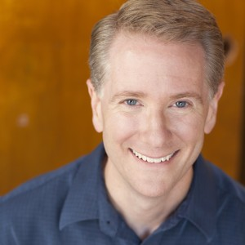
KEVIN LONG, Nominated for The 2015 Tony Award® for Excellence in Theatre Education, is the Director of Theatre and Associate Professor of Theatre at Harper College, the recipient of the Illinois Theatre Association’s 2012 Award for Excellence in College Theatre Teaching, an associate member of the Stage Directors and Choreographers Society, and the President of the Illinois Communication and Theatre Association. Kevin has worked professionally in various equity and summer stock theatres in New Jersey, Pennsylvania, West Virginia, Indiana and Illinois. Kevin has been teaching acting and theatre classes for over twenty-five years and has directed over sixty productions including his highly acclaimed production of Parade (Winner Best Revival of a Musical, Resident Non-Equity by BroadwayWorld Chicago, Nomination Best Direction of a Musical). Kevin has earned elite status as the only director who has completed Alfred Uhry’s Atlanta Trilogy (direction of three shows Parade 2013, Driving Miss Daisy 2013 and The Last Night of Ballyhoo 2014) capped off with a visit in June, 2014 from Alfred Uhry and presenting/directing An Evening with Alfred Uhry. Additionally, Kevin frequently presents his workshop “Shakespeare Whispers in Your Ear,” which explores the language and theatre of Shakespeare through the use of the First Folio. Most notably, he has taught Folio Technique at Chicago Shakespeare Theater’s teacher workshops for Othello, The Tempest, Macbeth, King Lear, Henry V and The Comedy of Errors as well as Chicago Shakespeare’s “Bard Core” Teacher Professional Development Program and their “Battle of the Bard” Competition. kevinlongdirector.com
Director of Theatre | Associate Professor
www.kevinlongdirector.com
Harper College 1200 W. Algonquin Road
Palatine, IL 60067
847.925.6944
klong@harpercollege.edu

